Slide 1
聲學傳遞函數盲估計以應用於去混響、聲源分離以及增強 Blind estimation of acoustic transfer functions with application to signal dereverberation, source separation, and speech enhancement Date：2024. 07. 24
Telecom Electroacoustics Audio(TEA) Lab
Presenter: 袁安志
Research supervisor : 白明憲
Notes:
Hello everyone
I’m today’s presenter siang. I’m going to share some of my present work in source separation problem. My topic is comparative studies of source separation using semi-blind and blind source separation approaches.

Slide 2
Outline
Chapter 1 Introduction
Chapter 2 Baseline approach
Chapter 3 Signal model
Chapter 4 Proposed method
Chapter 5 Simulations
Chapter 6 Experiments
Chapter 7 Conclusions and Future work
References

Slide 3
Chapter 1 Introduction
Motivation
Literature review

Slide 4

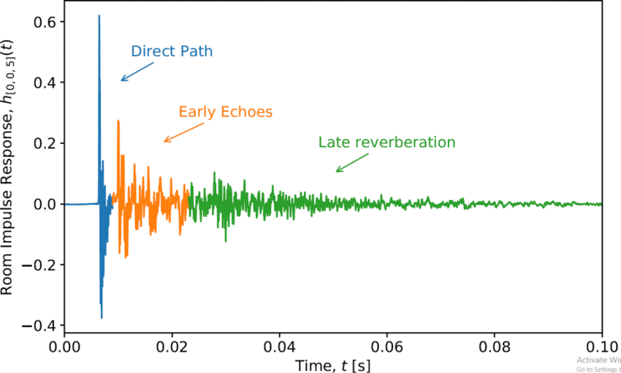


Motivation
Acoustic transfer functions (ATFs) v.s. Relative transfer functions (RTFs)
Unavailability of the source signal
Most blind system identification (BSI) → multiplication transfer function (MTF)
Proposed method → convolutive transfer function (CTF)
ATF
RTF
Amplitude
Time samples

Slide 5
Literature review
Subspace (SS) algorithm
[3]
Higher-order statistics
[1]
Second-order statistics (SOS)
[2]
Cross relation (CR) algorithm
[4]
Slow convergence
local minimum
Blind system identification (BSI)
Computatioally intensive
Difficult in adaptive mode
Time domain adaptive eigenvalue decomposition
algorithm (TAEDA)
[5]
Frequency domain adaptive eigenvalue decomposition
algorithm (FAEDA)
[6]
Short RIR

Slide 6
Chapter 2 Baseline approach

Slide 7
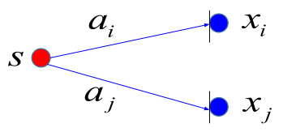
Baseline approach (state-of-the-art BSI method)

Slide 8
Chapter 3 Signal model

Slide 9
Signal model
s(n)
y(n)
a(n)

Slide 10
Chapter 4 Proposed method
Flow chart
TDOA-based source localization
Pre-processing
Wiener filter approach
RLS approach
Kalman approach
ATF reconstruction
Parameters optimization

Slide 11

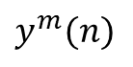
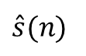
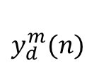
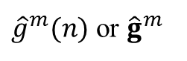

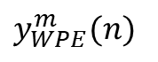
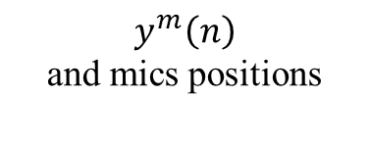
Flow chart
Parameters optimization
$$y_{d}^{m}(n)$$
Signal
delay
Parameters optimization
Wiener filter approach
RLS approach
Kalman filter approach
$\hat{A}$
Pre-processing
ATF reconstruction
Weighted
prediction
error (WPE)
Three CTF coefficients estimated approach
ATF reconstruction
Acoustic
applications
DAS
beamformer
$y^{m}(n)$
s_{DAS,p}
$\hat{A}$
${\hat{g}}^{m}(n)$ or ${\hat{g}}^{m}$
$\hat{s}(n)$
$y_{WPE}^{m}(n)$
TDOA-based source localization
source position
$$y^{m}\left(n\right)$$
and mics positions
TDOA-based source localization

Slide 12
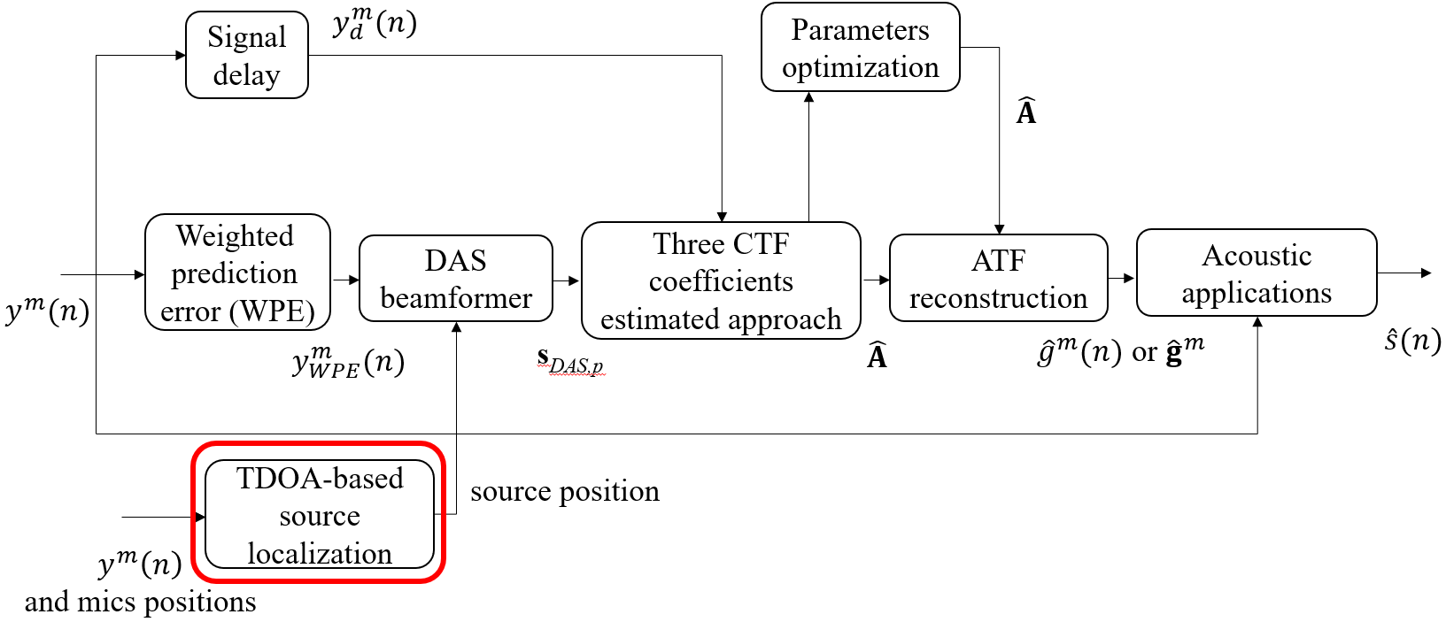
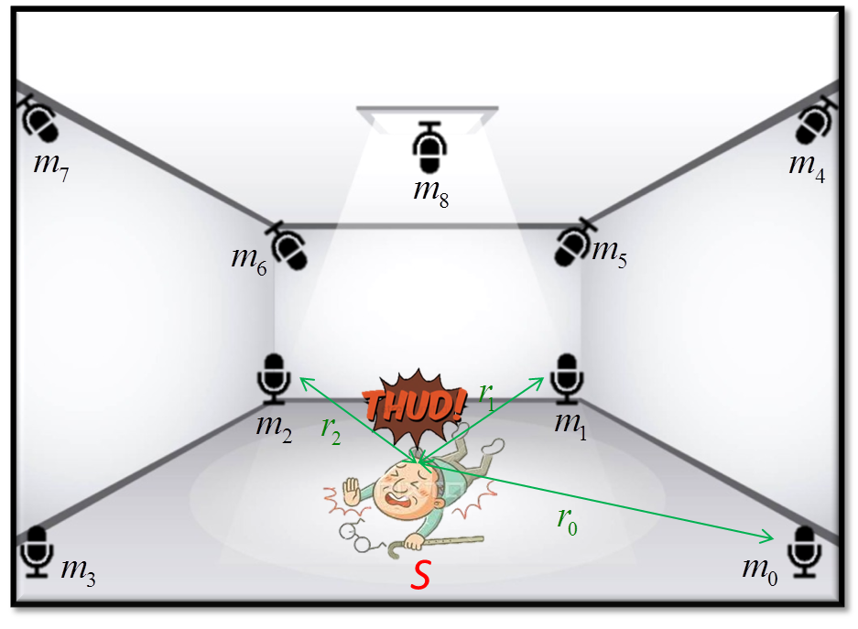
TDOA-based source localization

Slide 13
TDOA-based source localization

Slide 14
TDOA-based source localization

Slide 15
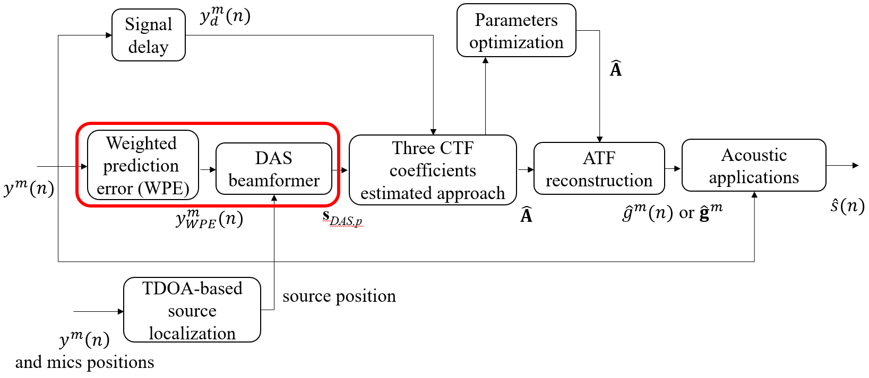
Pre-processing
WPE
Signal formation
Algorithm for WPE
DAS Beamformer

Slide 16
Signal formation
Time samples
D

Slide 17
Signal formation

Slide 18
Algorithm for WPE

Slide 19
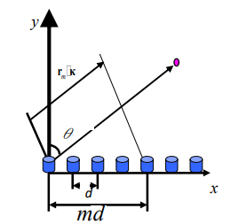
DAS beamformer
r^{m}

Slide 20
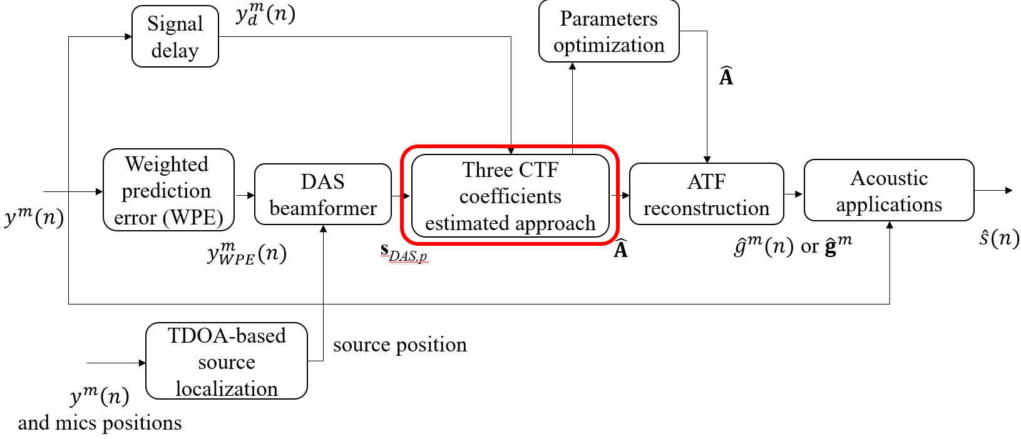
Wiener filter approach
RLS approach
Kalman filter approach

Slide 21
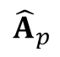
Wiener filter approach
y_{d,p}
s_{DAS,p}
R_{ss,p}
R_{sy,p}
${\hat{A}}_{p}$
Recursive average
Wiener filtering

Slide 22
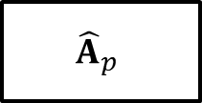
RLS approach
s_{DAS,p}
-
y_{d,p}
₊
$${\hat{A}}_{p}$$
∑
e_{p}

Slide 23
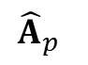
Kalman filter approach
y_{d,p}
s_{DAS,p}
Measurement update
(correction)
P_{Kalman,p│p}
$${\hat{A}}_{p}$$
P_{Kalman,p│p-1}
P_{Kalman,p-1│p-1}
No time update (prediction)

Slide 24
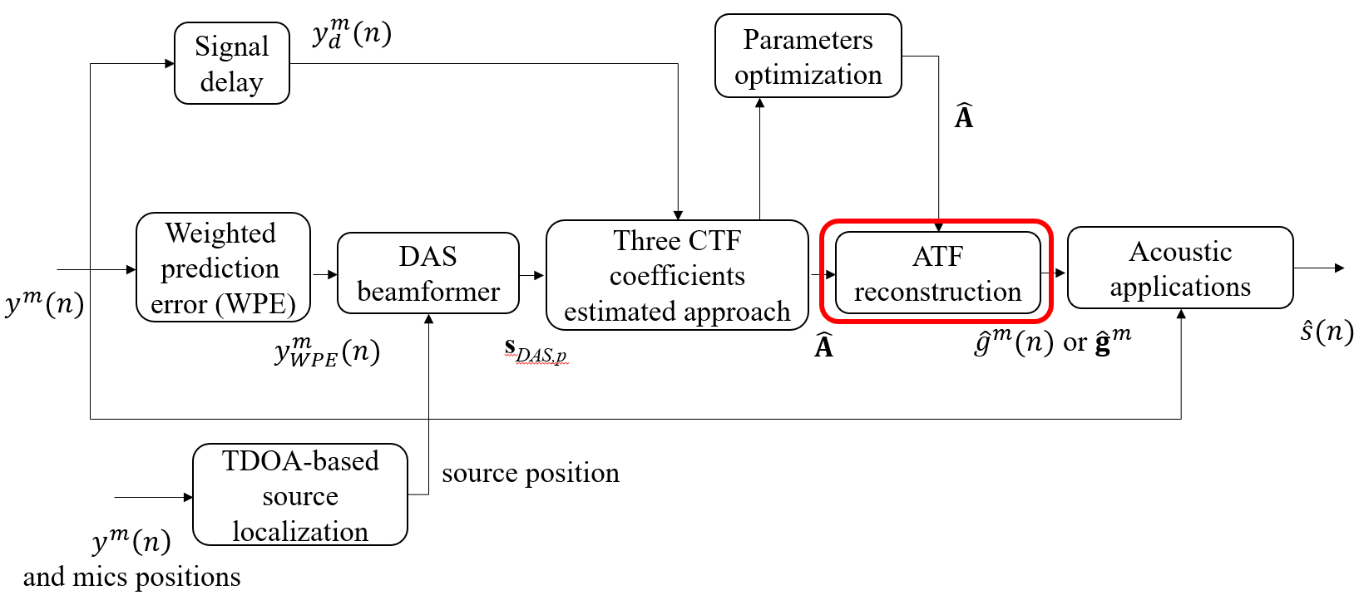
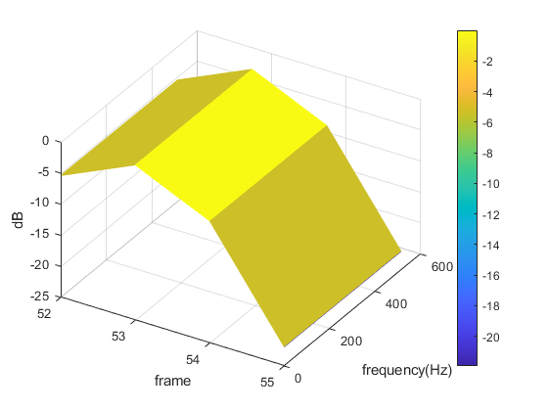
ATF reconstruction
δ_{p}
(k)

Slide 25
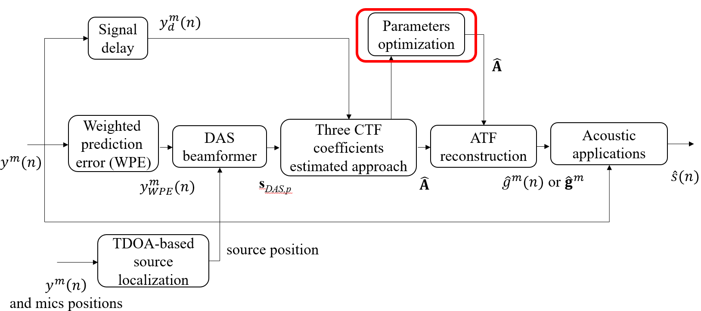
Parameters optimization
PSO
Concept of PSO
Flow chart of PSO
Equations of PSO
Which parameter ?
ASPSO
Flow chart of ASPSO
Equations of ASPSO

Slide 26
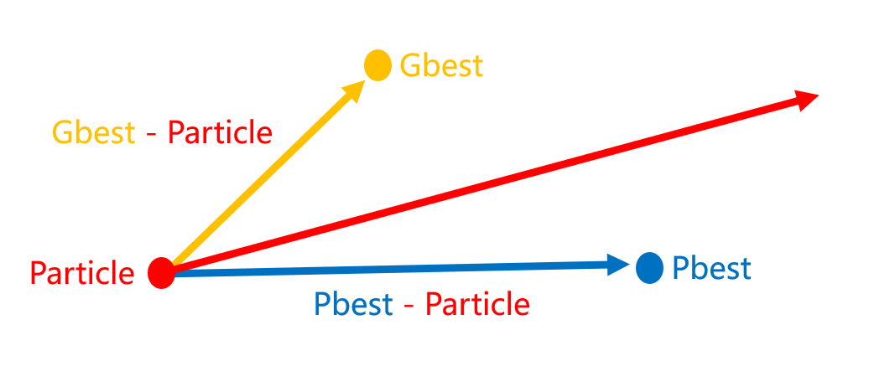
Concept of PSO
Optimization variable → Initial parameters in three CTF coefficients estimation approaches
Personal best location & Global best location
Global exploration ←→ Local exploitation

Slide 27
Flowchart of PSO
Randomly initialize particle locations X and velocities V
Calculate fitness of particle
Update pbest gbest
Stopping criteia met?
Output gbest
Yes
No
Update particle velocities and locations

Slide 28
Equations of PSO

Slide 29
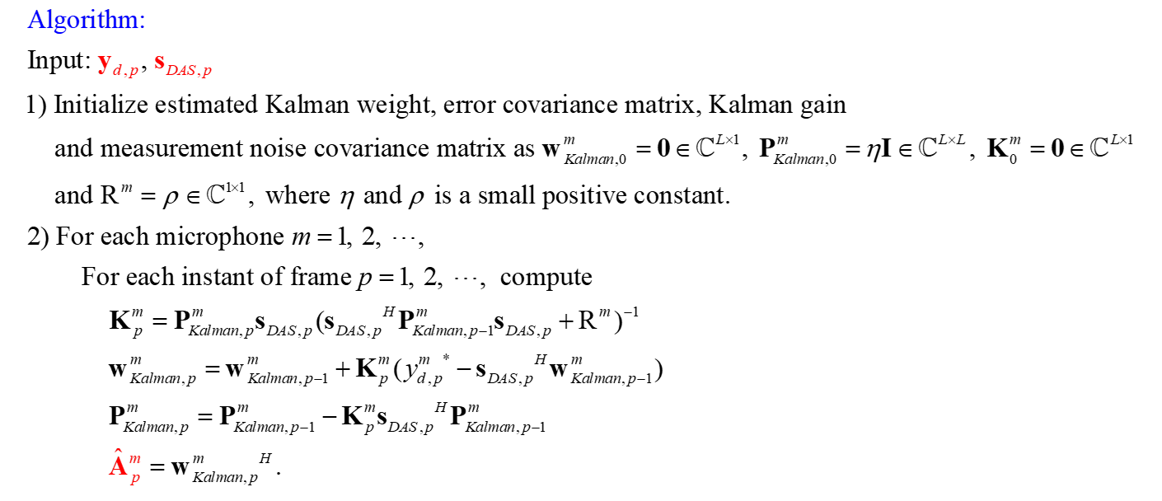
Which parameter?

Slide 30
Flowchart for ASPSO
Output gbest
Randomly initialize particle locations X and velocities V
Yes
No
Stopping criteia met?
4. Competitive substitution mechanism
Calculate fitness of particle
Update gbest
Update pbest gbest
1. Inertia weight with chaotic
Update pbest
Update inertia weight w_{in}
Replace the particle with the worst fitness
Select Cpbest
Calculate Fpbest
Calculate Mpbest
Update particle position
2. Elite and dimensional learning strategies
Update particle position using spiral-shaped mechanism
Update particle velocity
Yes
3. Adaptive position update strategy
β < rand?
No

Slide 31
Equations for ASPSO
1. Inertia weight with chaotic
2. Elite and dimensional learning strategies

Slide 32
Equations for ASPSO
3. Adaptive position update strategy
4. Competitive substitution mechanism

Slide 33
Chapter 5 Simulations
Fixed source location cases
Fixed source location with parameters optimization
Applications of estimated ATFs and RIRs
Moving source location cases

Slide 34
Fixed source location cases

Slide 35
Fixed source location with parameters optimization

Slide 36
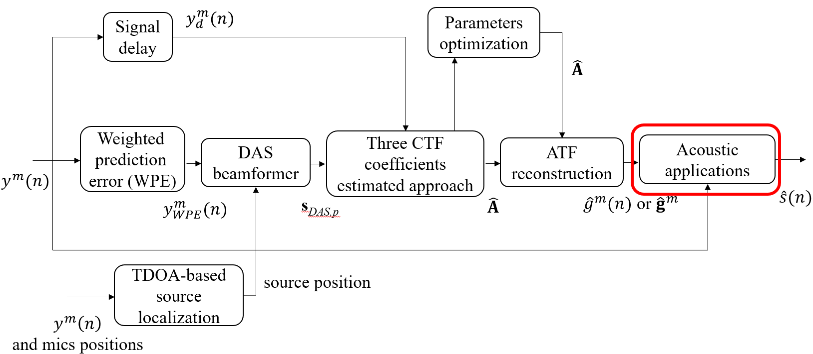
Applications of estimated ATFs and RIRs

Slide 37
Moving source location cases

Slide 38
Chapter 6 Experiments
Settings and Parameters
Results and Discussions

Slide 39
Settings and Parameters

Slide 40
Results and Discussions

Slide 41
Chapter 7 Conclusions and future work
Conclusions
Future work

Slide 42
Conclusions
Proposed three approaches
Accurate ATF estimation
low matching error
In short reverberation time scenarios
Proposed method outperform baseline BSI method
In long reverberation time scenarios
baseline BSI method → failure
Proposed method outperform WPE following DAS beamformer
Parameters optimization
Lower matching error

Slide 43
Future work
Moving sources → Process noise in Kalman non-stationary filter
Real experiments
State-of-the-art BSI → CTF signal model

Slide 44
References
Y. Sato , “ A method of self-recovering equalization for multilevel amplitude-modulaion IEEE Trans. Commu, vol. 23, no. 6, pp. 679-682, 1975.
L. Tong, G. Xu, and T. Kailath, “A new approach to blind identification and equalization of multipath channels,” Proc. 25th Asilomar Conf. Signals, Syst., Comput, vol. 2, pp. 856–860, 1991.
E. Moulines, P. Duhamel, J. F. Cardoso, and S. Mayrargue, “Subspace methods for the blind identification of multichannel FIR filters,” IEEE Trans. Signal Processing, vol. 43, pp. 516–525, Feb. 1995.
H. Liu, G. Xu, and L. Tong, “A deterministic approach to blind equalization,” Proc. 27th Asilomar Conf. Signals, Syst., Comput, vol. 1, pp. 751–755, 1993.
Y. Huang and J. Benesty, “Adaptive multi-channel least mean square and Newton algorithms for blind channel identification,” Signal Processing, vol. 82, no. 8, pp. 1127–1138, Aug. 2002.
M. A. Haque and M. K. Hasan, “Noise robust multichannel frequency-domain LMS algorithms for blind channel identification,” IEEE Signal Processing Letters, vol. 15, pp. 305–308, 2008.
T. Nakatani, T. Yoshioka, K. Kinoshita, M. Miyoshi and B. -H. Juang, “Speech Dereverberation Based on Variance-Normalized Delayed Linear Prediction,” IEEE Trans. Audio, Speech, Lang. Process., vol. 18, no. 7, pp. 1717–1731, 2010.
Rui ang, Kuangrong Hao, Lei Chen, Tong Wang, and Chunli Jiang, “A novel hybrid particle swarm optimization using adaptive strategy,” Information Sciences, vol. 579, pp. 231-250, 2021.
S. A. U. Islam and D. S. Bernstein, “Recursive Least Squares for Real-Time Implementation,” IEEE Control Systems Magazine, vol. 39, no. 3, pp. 82-85, June 2019.

Slide 45


© anchi_0203

